Slide 1
INRODUCTION
My company has come up with innovative Stock Data Insights Platform that leverages technology to deliver real-time, advanced analytics of the NSE stock market. Designed to empower investors, traders, and financial institutions, Enlighten provides intuitive tools for data exploration, trend monitoring, and portfolio management. With its user-friendly interface and robust analytical capabilities, our platform is geared to revolutionize decision-making and optimize financial strategies in the capital markets

Slide 2
Addressing Market Analysis Challenges
Challenges: Investors, traders, and financial institutions struggle with the vast data volumes of the stock market, making it difficult to discern meaningful trends, patterns, and opportunities.
Existing Solutions Limitations: Many available tools fail to offer the necessary depth, customization, and real-time capabilities, hindering effective decision-making in the rapidly changing market environment.

Slide 3
Goals of the Stock Data Insights Platform
Advanced Analytics: Utilize Python libraries to provide deep insights into stock market data, enhancing analytical capabilities.
User-Friendly Interface: Feature an intuitive interface with robust visualization tools for straightforward data interpretation and analysis.
Real-Time Monitoring: Enable users to track market trends and changes as they happen, supporting agile decision-making.
Portfolio Optimization: Incorporate predictive analytics and risk management tools to aid in optimizing investment portfolios.

Slide 4

Who Stands to Gain?
Target audience: Financial analysts, traders, and individual as well as institutional investors. Needs Met: Perfect for people in need of sophisticated instruments for efficient data analysis and stock market exploitation.

Slide 5
The Stock Data Insights Platform provides
Cutting-edge analytics and insights driven by Spark technology, leveraging actual stock market data from the NSE.
Intuitive user interface equipped with interactive visualization tools for seamless data exploration and understanding.
Up-to-the-minute tracking of market trends and advancements to support prompt decision-making.
Enhanced portfolio management through predictive analytics, risk assessment, and tailor-made investment approaches.

Slide 6
CLEANING IN PYTHON
MODEL
TRAINING
LOADING INTO API
STOCK DATASET
DATA LOADING
EDA

Slide 7
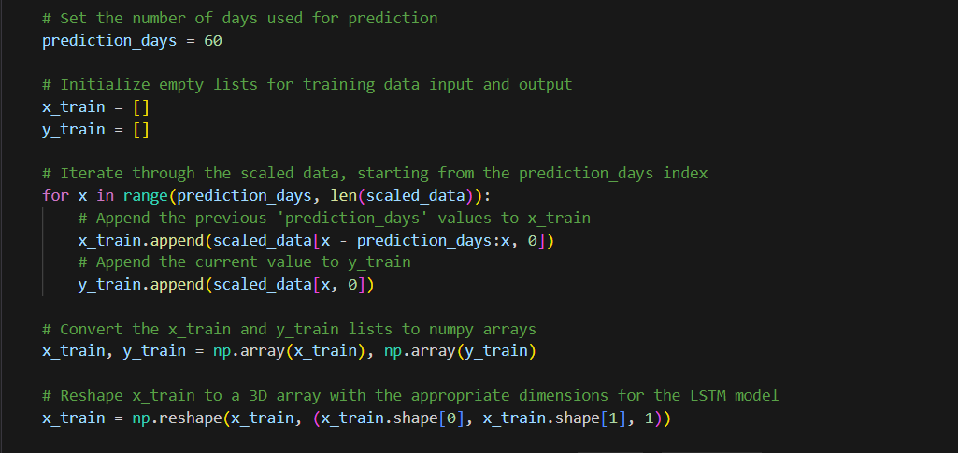
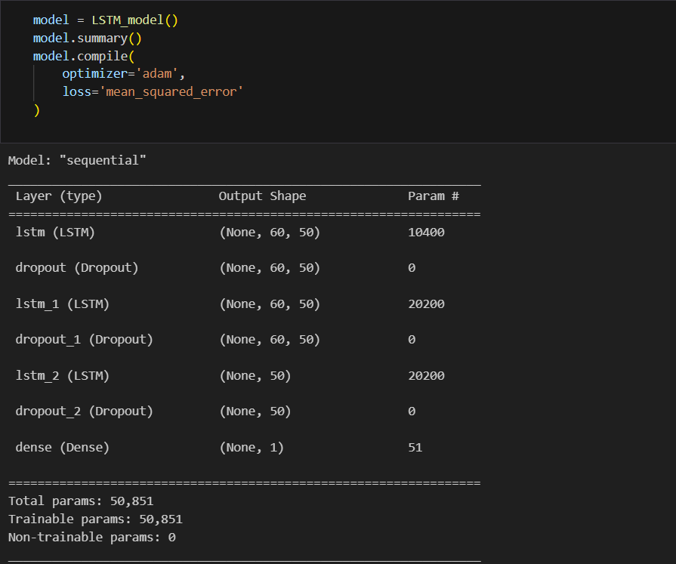
INSIGHT OF THE CODE

Slide 8
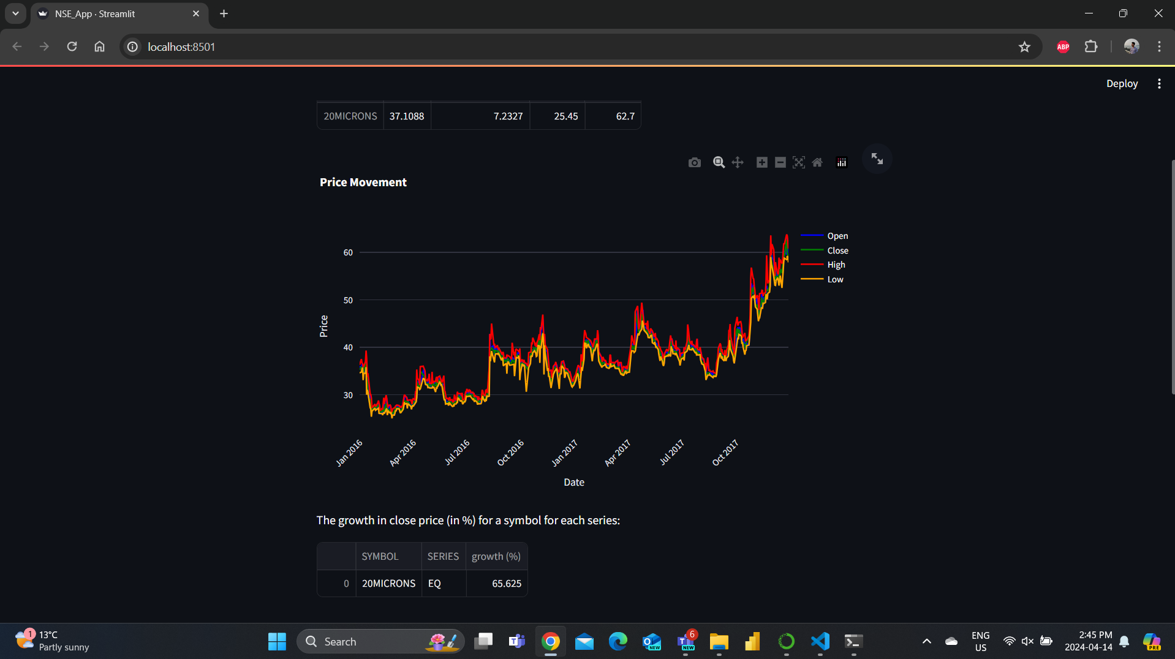
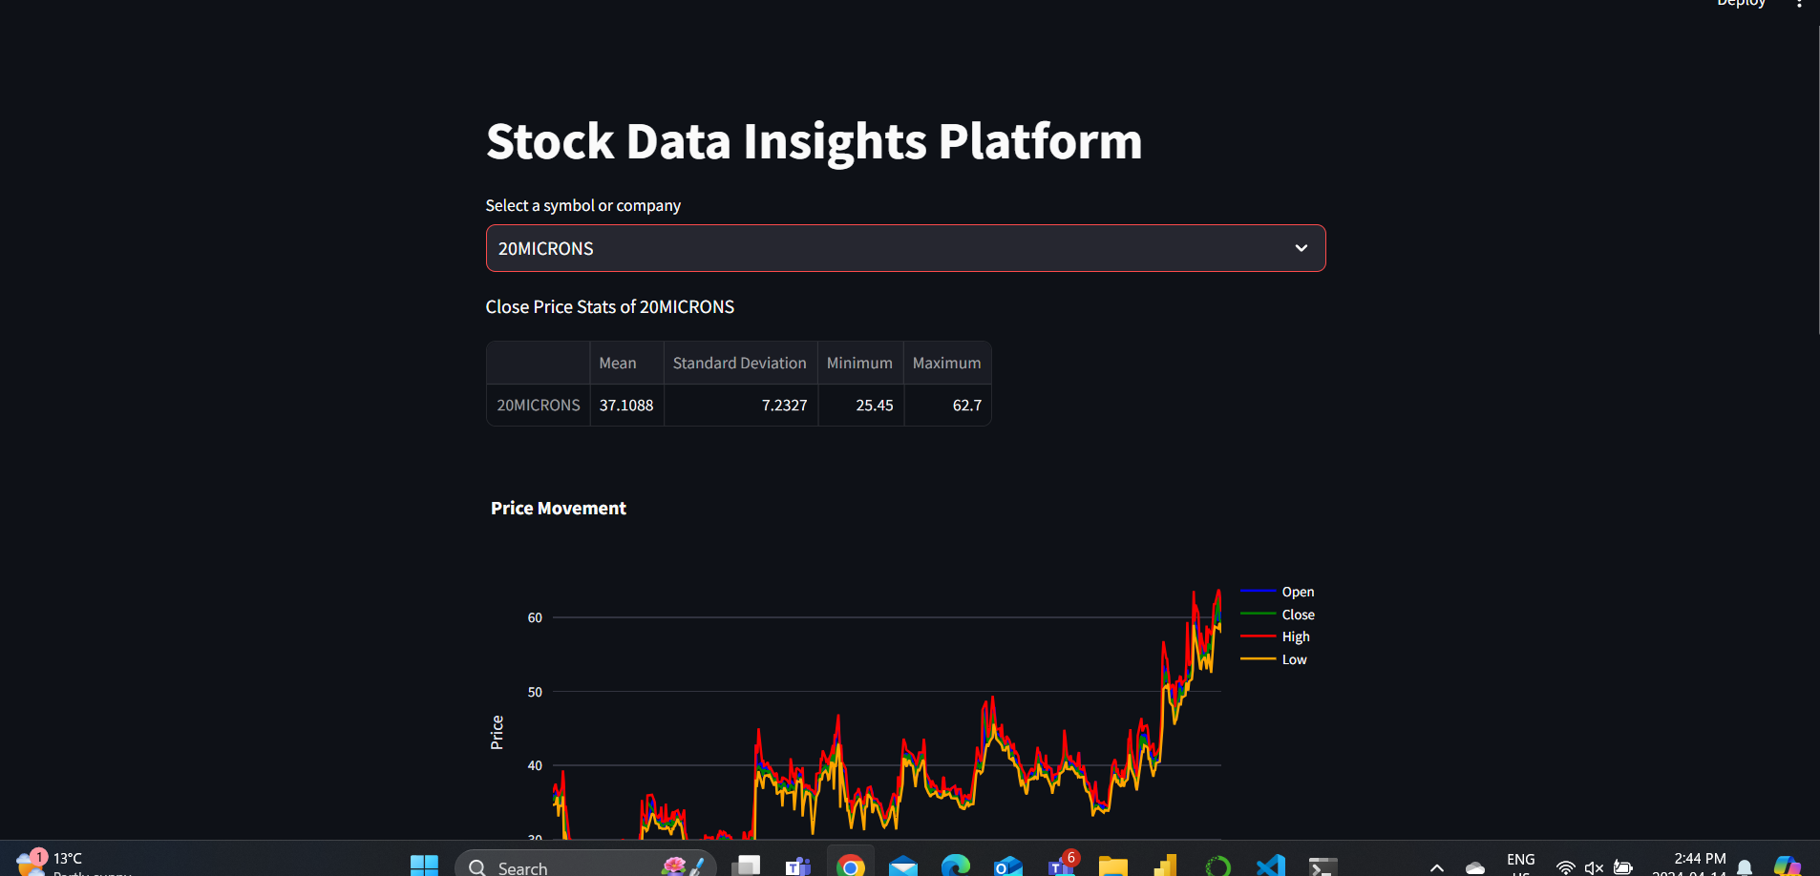
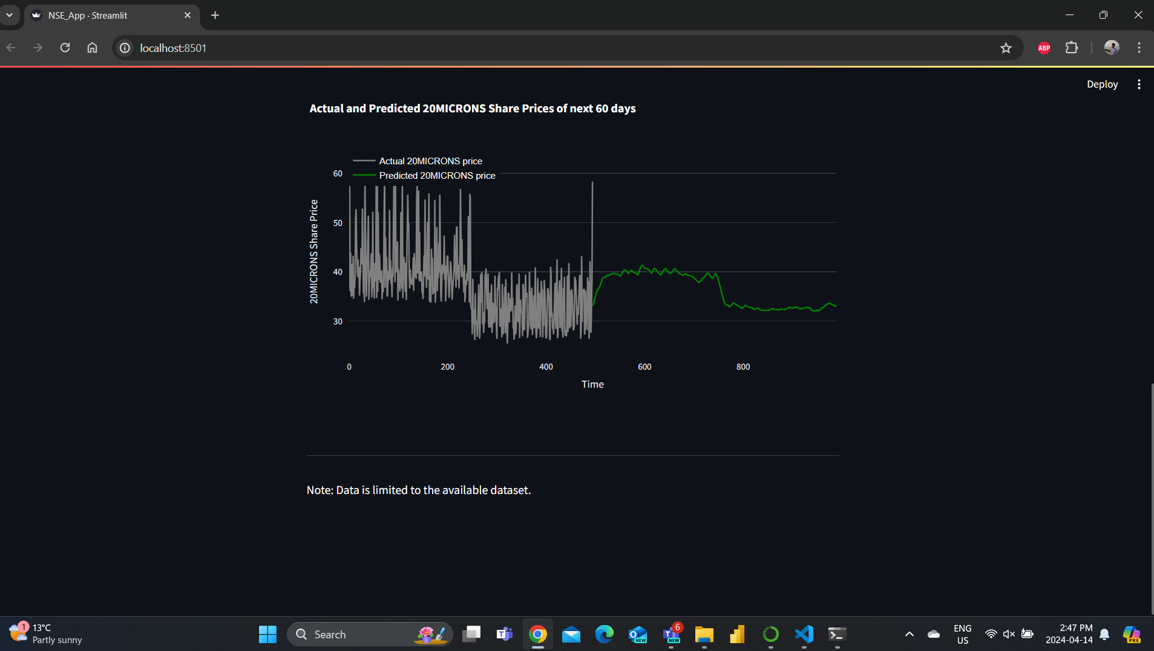
OUTPUT OF CODE

Slide 9



DATA VISUALIZATION - TABLAUE

Slide 10
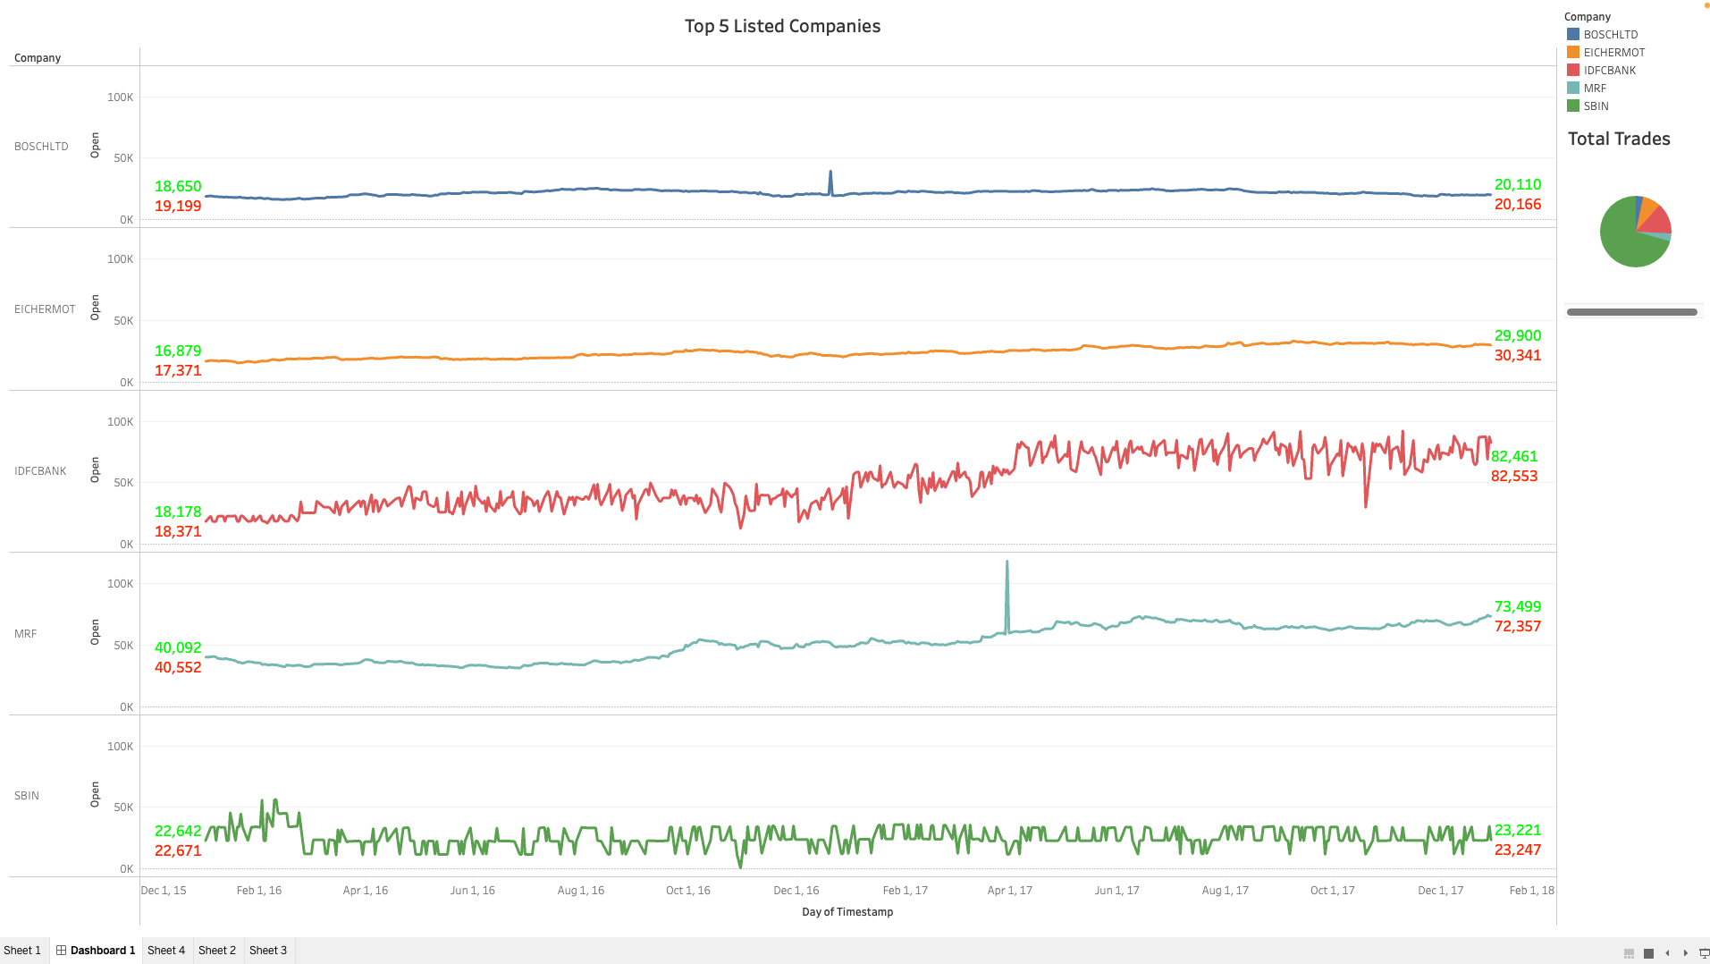

Slide 11
Improving Market Understanding using Our Platform
Tailored Analytics: Instead of using conventional models like Spark, our platform makes use of Python's powerful features to analyze data accurately and scalability. Interactive Experience: To provide all users with clear and useful insights, we combine cutting-edge visualization and real-time interaction technology. Proactive Monitoring: Our platform's real-time features allow for the proactive management of investment strategies, allowing us to remain ahead of market fluctuations. Strategic Benefits: Enlighten is made to enable customers to take advantage of market fluctuations and convert insights into profitable choices.

Slide 12

THANK YOU

